Slide 1
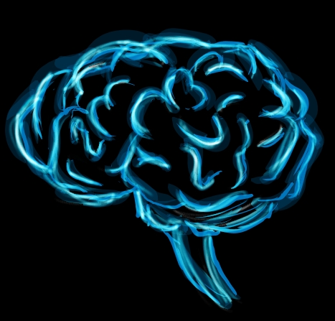
Growth Mindset:
What is it and how can we instill it in our students?

Slide 2
Fixed Mindset:
In a fixed mindset students believe their basic abilities, their intelligence, their talents, are just fixed traits. They have a certain amount and that’s that, and then their goal becomes to look smart all the time and never look dumb.
—Carol Dweck, Stanford University

Slide 3
Growth Mindset:
In a growth mindset students understand that their talents and abilities can be developed through effort, good teaching and persistence. They don’t necessarily think everyone’s the same or anyone can be Einstein, but they believe everyone can get smarter if they work at it.
—Carol Dweck, Stanford University

Slide 4
Fixed vs. Growth Mindsets
·The belief that intelligence is static, ·The belief that intelligence can be
pre-determined , something you are born with, developed through effort, perseverance,
cannot be changed. and motivation.
·A tendency to avoid challenges out of fear of ·Challenges are embraced and seen as an
not appearing smart. opportunity to learn and “grow your brain”.
·A tendency to give up easily when an obstacle ·Perseveres when faced with a setback.
presents itself.
·Useful, negative criticism is ignored and ·Learns from criticism and finds lessons
feels threatened by the success of others. and inspiration in the success of others.
·Only kids who are not smart have to try hard ·Understands that effort is how we get
and if I have to try hard, then I must not be smart. smarter.

Slide 5
Potential Outcomes of
Fixed vs. Growth Mindsets
-As a result of a Fixed Mindset, a child may +As a result of a Growth Mindset, a child is may plateau early and achieve less than their likely to reach even higher levels of
full potential. achievement and have a greater sense of
autonomy.

Slide 6
How can a Growth Mindset be Cultivated?
Praise a child’s effort not their ability
Say Don’t Say
“Wow! You must have worked really hard on that!” “You are so smart!”
“You work so hard and it shows!” “You are really athletic!”
“I love the way you embrace a challenge!” “I was never good at math, you’re
just like me.”
·Educate children about how the brain works.
·Help them to understand that failure is not something to fear, but an essential part of learning.
·Emphasize that Effort + Motivation + Persistence = SUCCESS!

Slide 7
Keep it Growing!

